Slide 1
Internship Report

Slide 2

Introduction
This presentation summarizes a 60-hour web development internship focused on Django and the Vehicle Renewal System project.
The internship combined theory, hands-on coding, and project-based learning to build a functional online platform for RC renewal and related services.

Slide 3

01
Internship Summary

Slide 4
Duration & Structure
60 hours split across theory sessions, practical coding, and a capstone project. Weekly plan covered Python basics, Django components, frontend integration, and final system development and testing.
Tools: Python, Django, HTML, CSS.

Slide 5

Objectives & Outcomes
Primary goals: gain practical web development experience, understand Django architecture, and apply concepts in real applications. Outcome: a working Vehicle Renewal System prototype with core modules implemented and tested, and improved problem-solving skills.

Slide 6
Schedule & Tools
Internship spanned 60 hours with a 4-week plan: Python basics, Django models/views/templates, frontend integration, and final project development.
Tools used: Python, Django, HTML and CSS for the database.

Slide 7
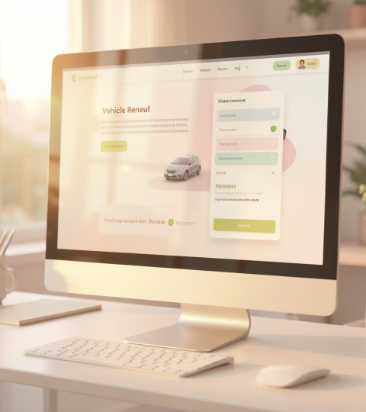
01
Vehicle Renewal System

Slide 8
Project Overview
The Vehicle Renewal System is an online platform for RC renewal, ownership transfer, and fee payments, enabling a paperless, digital process.
It streamlines renewals, tax payments, and address updates to reduce visits to the RTO and improve user convenience.

Slide 9

System Modules
Vehicle Registration: new registrations, renewals, ownership transfers.
Taxation: calculates state-wise road tax, green taxes, and government levies.
User Interface: frontend forms, validation, and status tracking.

Slide 10
Development & Challenges
Development followed requirement analysis, database design, backend (Django) and frontend implementation, then testing.
Key challenges: mastering Django , form validation, frontend-backend integration, and debugging complex errors.

Slide 11
Conclusions
The internship achieved practical web development skills and produced a working Vehicle Renewal System prototype.
Outcomes: improved problem-solving, applied Django architecture knowledge, and a tested, modular application ready for further enhancement.

Slide 12

Thank you
Thank You

